Slide 1
GENOME ANALYSIS, ASSEMBLY and ANNOTATION studies
By
Mrs. Aparna Patil Kose
Lecturer
Dept of Bioinformatics

Slide 2
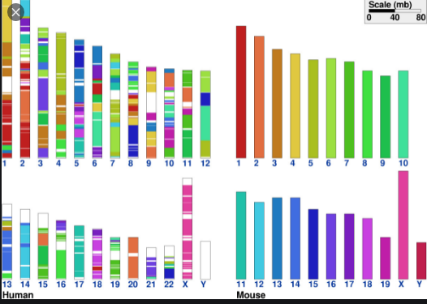
Synteny and gene order
synteny describes the physical co-localization of genetic loci on the same chromosome within an individual or species. OR Linked genes is conserved between genomes.
It refers to conservation of blocks of order within two sets of chromosomes that are being compared with each other.
Use:
Provides a framework in which conservation of homologous genes and gene order is identified between genomes of different species.
The availability of human and mouse genomes paved the way for algorithm development in large scale called as synteny mapping, which eventually became an integral part of comparative genomics.

Slide 3
What is synteny mapping? Comparisons between genomes reveal homologous sequences that reflect their common evolutionary origin and subsequent conservation. Sequence conservation between species, within genic and non genic regions, can be utilized for the construction of physical maps.
GENE ORDER: The permutation of genome arrangement. Research has been performed to determine whether gene orders evolve according to a molecular clock hypothesis or not.
Gene order is much less conserved compared with gene sequences.
Gene order conservation is in fact rarely observed among divergent species.
Therefore, comparison of syntenic relationships is normally carried out between relatively close lineages.
However, if syntenic relationships for certain genes are indeed observed among divergent prokaryotes, they often provide important clues to functional relationships of the genes of interest .
Eg: Genes involved in the same metabolic pathway tend to be clustered among phylogenetically diverse organisms. The preservation of the gene order is a result of the selective pressure to allow the genes to be coregulated and function as an operon.

Slide 4
reference genome sequence/ reference genome ASSEMBLY (Https://www.Futurelearn.Com/info/courses/whole-genome-sequencing/0/steps/16798)
A reference genome (also known as a reference assembly) is a digital nucleic acid sequence database, assembled by scientists as a representative example of the set of genes in one idealized individual organism of a species.
Genome Assembly are Blueprint against which comparison to be done
EG: the human reference genome doesn’t represent the genetic sequence for any one individual, but is made up of a combination of several people’s DNA. When we sequence a patient’s genome and compare it to the reference genome, we assume that the reference represents the ‘normal’ sequence, and therefore any identified variation could be responsible for problems.
How to search this:
Gene database/ NCBI genome database/ UCSC/1000 genomes/ensemble/HUGO/HGNC database, etc
Search gene name, product name, or symbol. ...
Click on the desired gene.
Click on "reference sequences" and search

Slide 5
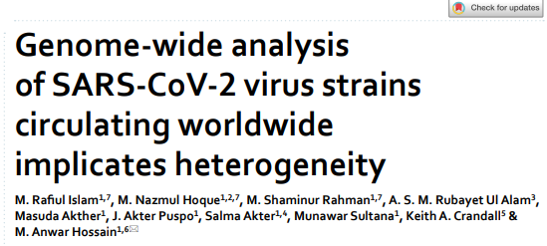
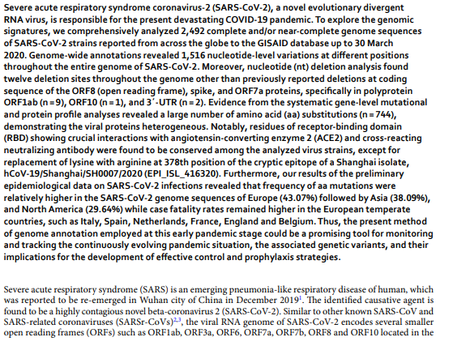

Slide 6
Gene expression profiling
The determination of the pattern of genes expressed, at the level of transcription, under specific circumstances or in a specific cell to give a global picture of cellular function.
Advantage:
Undersand molecular mechanisms of complex disorders
Cancer studies
Metabolic disorder studies etc…..
Methods for analysis:
Microarray
RT-PCR
SAGE
Northern blot
ELISA Test
Western Blot etc……..
Ref:
https://www.youtube.com/watch?v=IN2FnaGC3t8
https://www.youtube.com/watch?v=Hv5flUOsE0s
https://www.thermofisher.com/blog/behindthebench/next-generation-sequencing-for-gene-expression-analysis-seq-it-out-11/

Slide 7
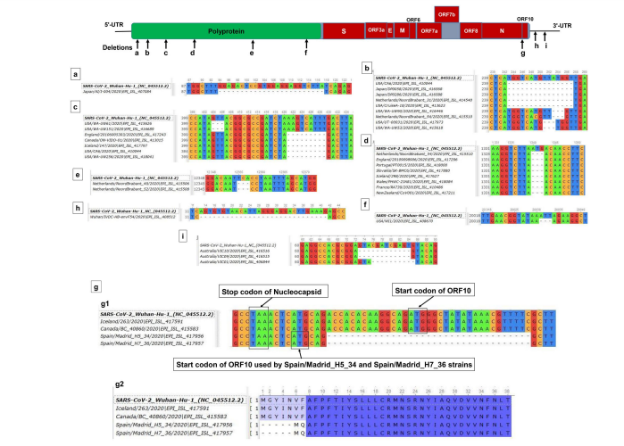

Slide 8
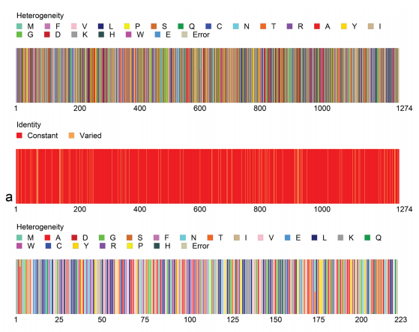
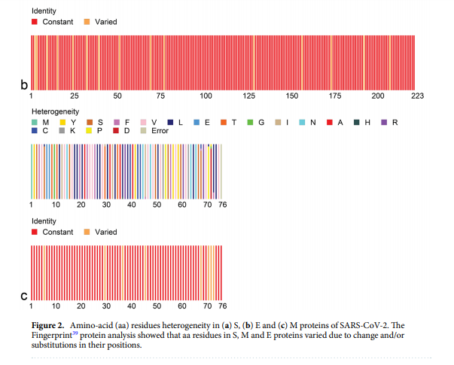

Slide 9
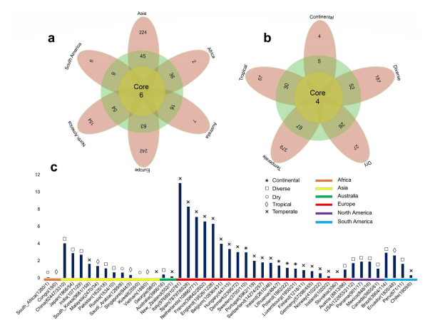
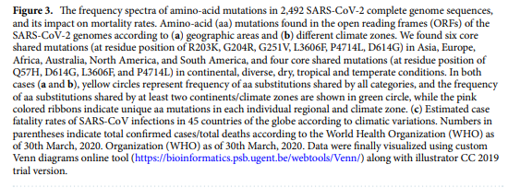

Slide 10
Structural variants of DNA
Relevance in molecular level processes
Identification
Assembly of data from genome sequencing

Slide 11
Structural variants?
Structural variation refers to large scale structural differences in the genomic DNA that are inherited and polymorphic in a species.
Types of structural variants are there?
Microscopic and Submicroscopic structural variants such as
deletions,
duplications,
large copy number variants as well as insertions, inversions, and translocations.
Structural variants in the human genome are quite distinctive from each other.

Slide 12
What is a variant DNA?
Variant is an alteration in the most common DNA/RNA nucleotide sequence.
Variants are defined based on the type of DNA/RNA error.
Variant can be used to describe an alteration that may be pathogenic, or of unknown significance.
Variants may be germline or somatic.

Slide 13
Why are structural variants important?
Structural variants (SVs) has established their importance to medicine and molecular biology, elucidating their role in various diseases, regulation of gene expression, ethnic diversity, and large-scale chromosome evolution—giving rise to the differences within populations and among species.

Slide 14
How do you identify structural variations?
Detection of structural variation is an active research area and different methods are being explored with different applications.
It is widely agreed that the method can be classified into four different algorithms: read-pair (RP), split-read (SR), read-depth (RD) and assembly.

Slide 15
What sequencing technology can be used to detect structural variants?
Especially, long-read sequencing is powerful to detect structural variants and repetitive sequences. Strand-seq is the most suitable detection method for chromosomal inversions, a particularly challenging group of structural variants.

Slide 16
28.14: DNA Sequencing.
Maxam-Gilbert: relys on reagents that react with a specific DNA
base that can subsequent give rise to a sequence
specific cleavage of DNA
Sanger: Enzymatic replication of the DNA fragment to be
sequenced with a DNA polymerase, Mg⁺², and
dideoxynucleotides triphosphate (ddNTP) that truncates
DNA replication
Restriction endonucleases: Bacterial enzymes that cleave
DNA at specific sequences
5’-d(G-A-A-T-T-C)-3’
3’-d(C-T-T-A-A-G)-5’
5’-d(G-G-A-T-C-C)-3’
3’-d(C-C-T-A-G-G)-5’
EcoR I
BAM HI

Slide 17
Sanger Sequencing:
key reagent: dideoxynucleotides triphosphates (ddNTP)
When a ddNTP
is incorporated
elongation of
the primer is
terminated
The ddNTP is
specifically
incorporated
opposite its
complementary
nucleotide base

Slide 18
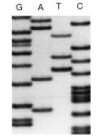
Sanger Sequencing
Larger
fragments
Smaller
fragments

Slide 19
Bioinformatics Sequencing Method
Structural Variation Detection from
Next Generation Sequencing
(Ref: Structural Variation Detection from Next Generation Sequencing, Kai Ye 1*, George Hall2,3 and Zemin Ning2, Journal of Next Generation Sequencing & Applications, DOI: 10.4172/2469-9853.S1-007 )

Slide 20
SEQUENCING DEVELOPMENT- NGS Video: https://sapac.illumina.com/science/technology/next-generation-sequencing.html https://www.abmgood.com/marketing/knowledge_base/next_generation_sequencing_introduction.php
DNA, contains the blueprints of life.
Within its structures are the codes required for the assembly of proteins and non-coding RNA – these molecular machineries affect all the biological systems that create and maintain life.
By understanding the sequence of DNA, researchers have been able to elucidate the structure and function of proteins as well as RNA and have gained an understanding of the underlying causes of disease.
Next Generation Sequencing (NGS) is a powerful platform that has enabled the sequencing of thousands to millions of DNA molecules simultaneously.
This powerful tool is revolutionizing fields such as personalized medicine, genetic diseases, and clinical diagnostics by offering a high throughput option with the capability to sequence multiple individuals at the same time.

Slide 21
Assembly of data from genome sequencing
Genome assembly refers to the process of taking a large number of short DNA sequences and putting them back together to create a representation of the original chromosomes from which the DNA originated. OR
In bioinformatics, sequence assembly refers to aligning and merging fragments from a longer DNA sequence in order to reconstruct the original sequence. ... Typically the short fragments, called reads, result from shotgun sequencing genomic DNA, or gene transcript (ESTs).
De novo genome assemblies assume no prior knowledge of the source DNA sequence length, layout or composition.

Slide 22
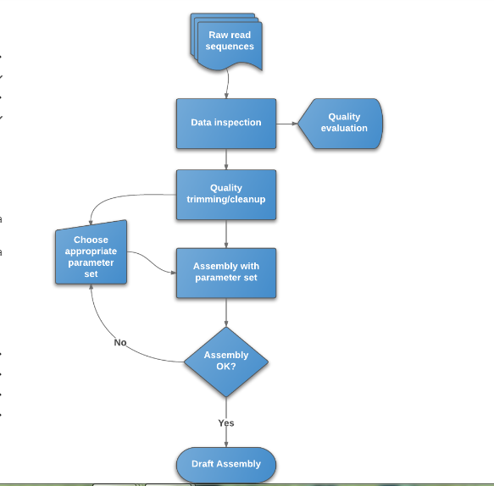
How do you assemble a genome sequence?

Slide 23
How do you assemble a genome sequence? STEPS
Step 1: Build a wide community for the project if possible
Step 2: Gather information about the target genome
Step 3: Design the best experimental workflow
Step 4: Choose the best sequencing platforms and library preparations
Step 5: Select the best possible DNA source and DNA extraction method
Step 6: Check the computational resources and requirements

Slide 24
Step 7: Choose the best computational design and pipeline
Step 8: Assemble the genome
Step 9: Check the assembly quality before annotation
Step 10: Genome annotation
Step 11: Build a searchable and sharable output format
Step 12: Reach out to the community to refine the assembly and annotation

Slide 25
Conclusions
There are no gold standards for genome assembly and annotation.
However, the availability of NGS data and their analytical tools has enabled the sequencing of several high-quality genomes of species of importance in aquaculture in recent years.
Beginners and small research groups still face challenges, because genome assembly and annotation are usually complex analytical procedures (or pipelines) requiring interdisciplinary collaborations (from biology to computer science) and hefty costs for refining/maintaining the genome.

Slide 26
Some important points to consider
● Availability of appropriate computational resources
● Collaboration with sequencing facility and bioinformatics groups
● Plan for amount and type of sequencing data needed
● Does funding allow to produce sufficient sequence coverage? If not, alternative approaches should be considered rather than producing a poor, low coverage, assembly
● Familiarization with data handling pipelines and file formats (see below)
● High‐quality DNA sample (with individual metadata)
● Plan for analyses and publication

Slide 27
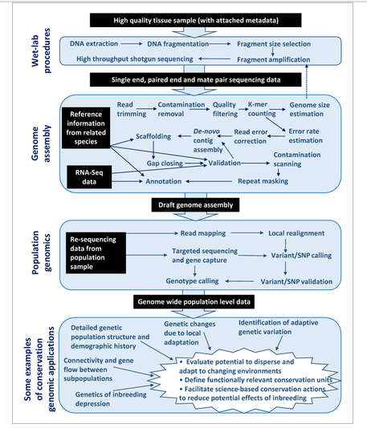

Slide 28
integrated genomic maps
What is meant by genome mapping?
Assigning/locating of a specific gene to particular region of a chromosome and determining the location of and relative distances between genes on the chromosome.
Mapping of physical and genetic maps
Used: Locating a specific gene to a particular region of a chromosome and to determine its relative distances between genes and molecular markers on the chromosome.
How is genome mapping done?
To map a set of STSs a collection of overlapping DNA fragments from a single chromosome or the entire genome is required. To do this, the genome is first broken up into fragments. The fragments are then replicated up to 10 times in bacterial cells to create a library of DNA clones. (Menhdi sir section)

Slide 29
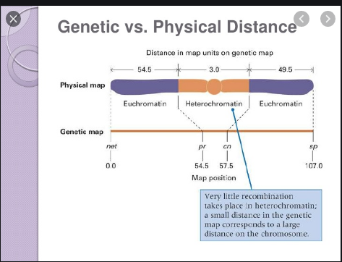

Slide 30
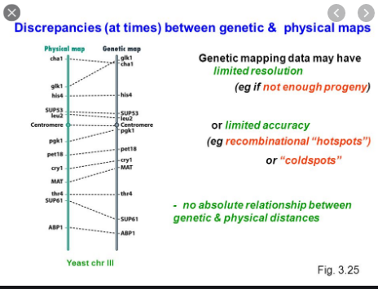

Slide 31
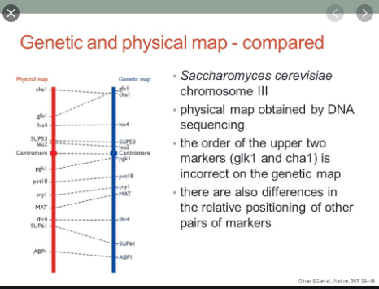

Slide 32
Approach for Genome Analysis
NGS
Short Gun
Dna Markers ( rflp, sslp, snp)
PCR
Microarray (protein microarray, dna microarray)
Restriction mapping
Fish
STS
EST
ETC……………………

Slide 33
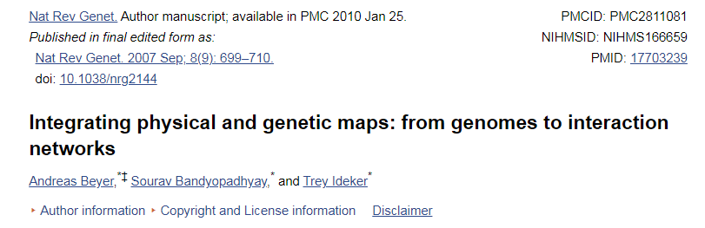
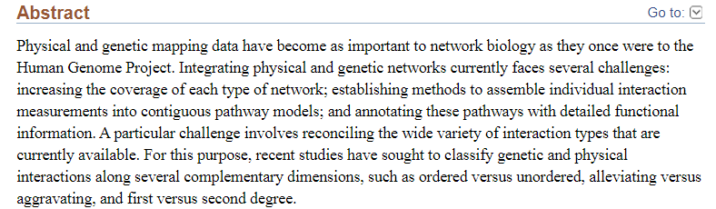

Slide 34
identification of disease genes AND role of bioinformatics Eg. OMIM database

Slide 35
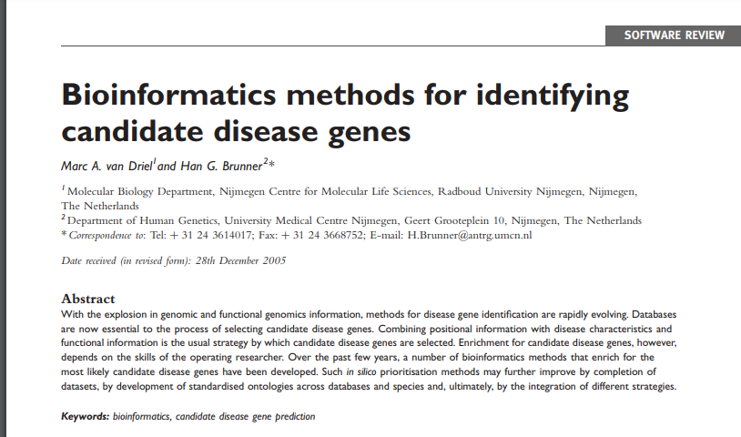

Slide 36
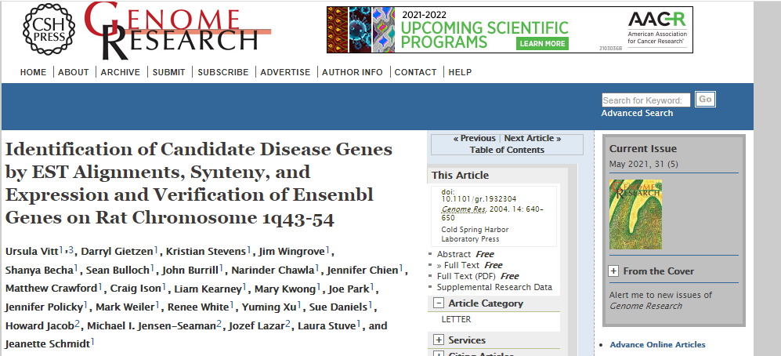
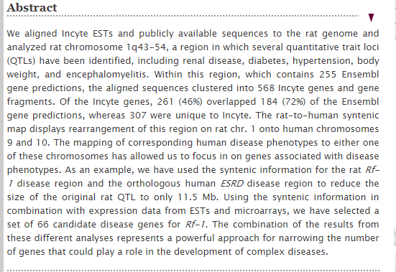

Slide 37
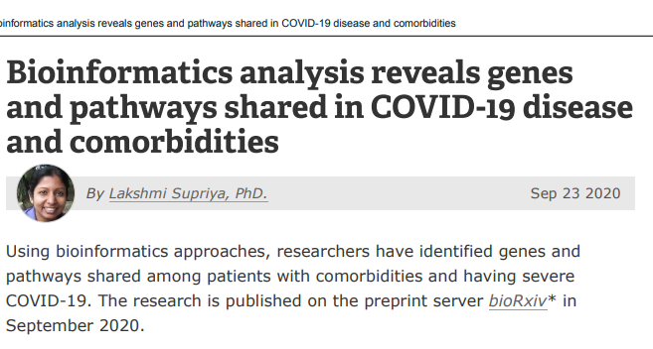
EXCELLENT (Short & sweet work)

Slide 38
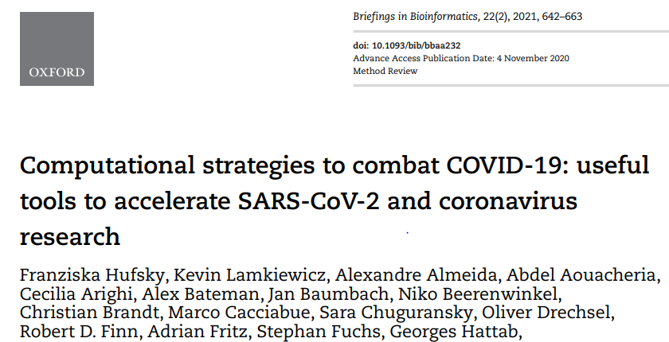
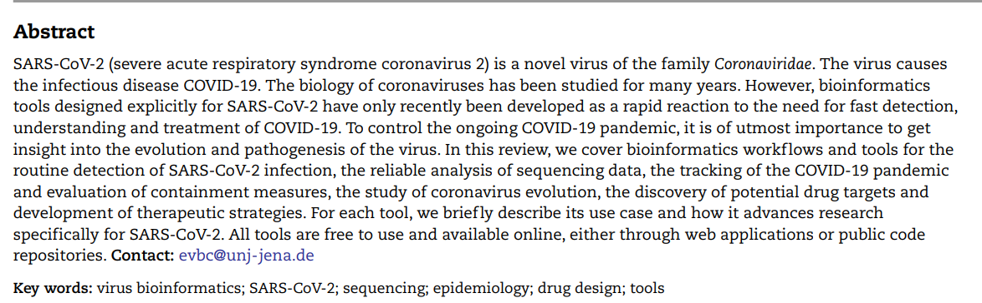
EXCELLENT Computational approach

Slide 39
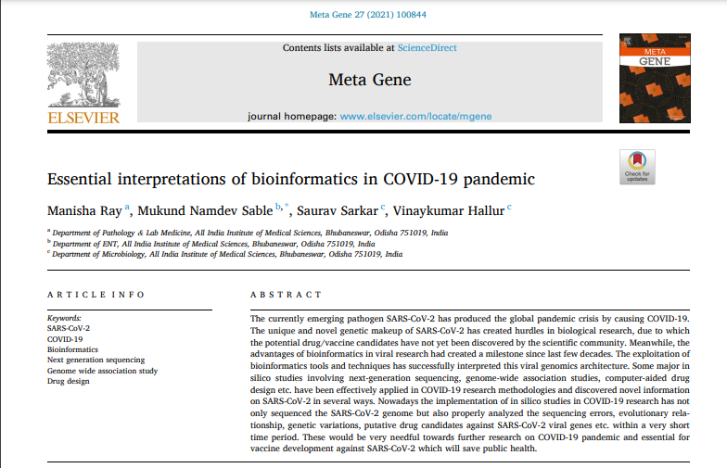
EXCELLENT Computational approach

Slide 40
THANK YOU

